Slide 1
Strategies Teachers Can Use To Avoid Classroom Burnout
Students Name:
Course:
Instructor:
Institution:

Slide 2
Introduction
Teaching is a demanding profession even though rewarding. Most are the time a teacher spends trying to research, and learn to acquire adequate knowledge for an effective delivery in the classroom.
Most teachers overwork themselves forgetting their mental and physical health.
They suffer from a state of chronic stress that primarily lead to mental and physical exhaustion, feeling ineffective, cynicism, lack of an accomplishment and detachment. The state is known as burnout (Tapp, 2017).
Notes:
Burnout has been identified as one of the biggest problems experienced by teachers in the US education system. When teachers get burnt out, everyone loses. The teacher, administrators, students, and even colleagues all feel the effects of one teacher losing their passion. Teachers experience burnout on a daily basis.

Slide 3
Definition
Burn out- this is a state of emotional, mental and physical exhaustion basically caused by overworking, excessive and prolonged stress.
The burnout signs in teachers can be categorized into;
  Mental
  Physical
Notes:
Burnout normally occur when someone feels overwhelmed by multiple unmet demands. According to Katrina Onstad in her book “The weekend effect” teachers are living in a “cult of overwork” and they become workaholic (Tapp, 2017). This is celebrated as a virtue when it is not supposed to be celebrated due to its effects to their health.
mental signs include; making careless mistakes they wouldn’t ordinarily make, lashing out at others because of stress and pressure. Depression, anxiety, hopelessness, helplessness, and resentful.
Physical signs include; teachers feeling exhausted due to sleeping less, lack of appetite, overthinking, experiencing constant and frequent dizzy spells, and weight loss.

Slide 4
Strategies Teachers to prevent Student Burnout
1. manage time effectively and prepare ahead of schedule
Proper time management is essential to reduce chances of overworking. A teacher should prepare a schedule and follow the pre-made plan all around the semester.
Schoolwork should be left at school. This calls for prioritizing and only working on the urgent tasks. however, should not procrastinate essential tasks not to be overwhelmed with excess work.
Notes:
Time management is all about doing the right time at the right time. time is a valuable resource that is never recovered once it is gone. Procrastination shouldn’t be an option as well (Zook, 2019).
For a teacher to manage time properly, the following are things to consider.
Prioritization- a teacher should assess the needs to achieve within certain timeframe. Setting priorities need to be done daily, weekly, monthly and even yearly. It will help handle urgent tasks first. Then will have adequate family time, sleeping time and time to workout (Zook, 2019).
Managing stress- it is never easy to perform tasks under excessive stress. A teacher need to have a healthy way to manage and handle work pressure while maintaining productivity. It is necessary to have time to be with friends and activities that are helpful in stress management.

Slide 5


Slide 6
2. Prepare ahead of schedule
To successful teach, a teacher needs to prepare in advance.
Arrive at school early enough at least 30 minutes before the reporting time.
Use the time to complete your pending work, check students work, grade the students’ papers, prepare your lesson plan.
Notes:
According to a study conducted in 2016, people who report to work early have ample time to prepare their day (Zook, 2019). A teacher has a variety of duties and work to handle before getting into a classroom. To avoid having pending work, it is necessary to use the morning time to manage the work.
Research for the lesson if needed before getting into the classroom. Answer emails and parents’ phone calls and get ready for the lesson. These morning activities prepare your mind for the tasks to be engaged during the day. Therefore, you can now focus on your students without worries of some essential pending tasks you haven’t completed.

Slide 7
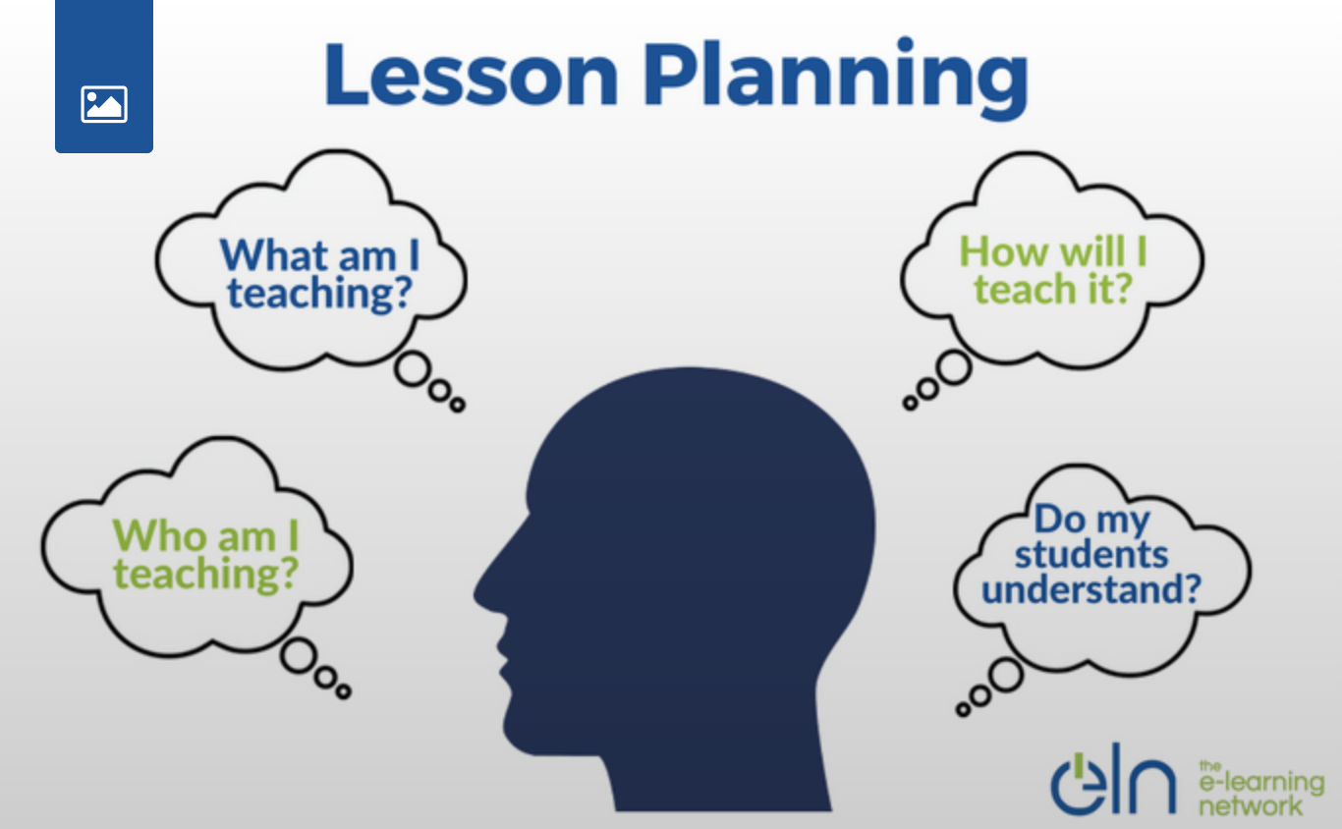

Slide 8
3. Maintaining good health
Personal wellness is essential for every individual. Overworking and stress can deteriorates a person’s health which can cause severe health conditions.
A teacher need to;
  Have healthy meals
  Engage in physical exercises
  Have ample sleeping time
  Engage in meditation exercises
Notes:
Burnouts are mental and psychological. This means it affects teachers who are not mentally fit causing stress.
Mental health can basically be managed through;
Eating healthy meals- balancing the diet is necessary to ensure that the body is gaining essential nutrients to function. They need to take more water (Wilson, 2014).
Exercises- workouts, relaxing walks, going swimming, regular deep breathing ,sports, and other physical exercises help to reduce mental-stress.
Enough sleeping time- the body requires enough time to relax. It is a requirement that a normal person should sleep at least 6 hours a day (Wilson, 2014).
Meditation sessions- there is a variety activities students can engage in to help them meditate. Yoga is among the best activities (Wilson, 2014).

Slide 9


Slide 10
4. Leave work at school
Many teachers struggling with burnout are normally workaholic.
They carry their work everywhere. You will see some seated at the parks, balconies of their homes, and in the vehicles going through students’ work.
It is unhealthy to exhaust the mind and body with activities that can be done at a later time.
Notes:
Every teacher need to understand that teachers’ work is never done. The feel completely caught up. However, this is never true since there is time for everything.
A teacher needs to put his/her health, family, friends and other leisure activities a priority after work. They are equally as important as the work they do but should not compromised (Wilson, 2014).
After completing the day’s activities, a teacher needs to think more on personal growth, activities that bring happiness to their life, and engaging in physical activities to remain fit both physically and mentally.

Slide 11
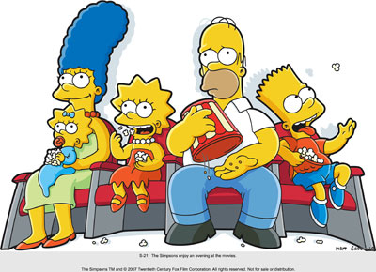
Family time after work

Slide 12
4. Fight back against burnout
According to experts, “Three R” approach is an effective and safe way to deal with burnout.
Recognize
Reverse
Resilience
Notes:
The “Three R” approach is considered effective in the following ways;
Recognize- Watching and recognizing warning signs should be the first essential thing. A teacher needs to work on the feeling of withdrawing from others, failing to handle tasks effectively, Shifting priorities and so on (Emerald Works Limited, 2021).
Reverse- after identifying the signs, a teacher needs to acknowledge the damage and reverse it by providing stress management skills.
Resilience- Thereafter, a teacher should take care of self physical and emotional health. This calls for creating ample time to take nature walks, enjoy with family members and friends, read interesting leisure books, engaging in physical exercises and so on (Emerald Works Limited, 2021).

Slide 13
Conclusion
The consequences of burnout to teachers can be severe if not managed effectively. Their productivity can drop intensely and negatively impact their careers.
Teachers can recover from burnout by applying right strategies. They can manage their stress, being organized, making themselves a priority, and recognizing what they can do well.

Slide 14
References
Emerald Works Limited, (2021). Avoid Burnout: maintaining a healthy, successful career. Retrieved February, 7,2021. https://www.mindtools.com/pages/article/avoiding-burnout.htm
Wilson, C (2014). Avoiding teacher burnout: five strategies. Retrieved February 8,2021 from https://www.educationworld.com/a_curr/teacher-stress-burnout-preventing.shtml
Zook, C. (2019). The 7 best ways to avoid teacher burnout in 2020. retrieved February 8, 2021 from https://www.aeseducation.com/blog/best-ways-to-avoid-teacher-burnout
Tapp, F. (2017). Teacher burnout: causes, symptoms, and prevention. Retrieved February 8, 2021 from https://www.wgu.edu/heyteach/article/teacher-burnout-causes-symptoms-and-prevention1711.html

